Slide 1
INLS 560 – List and For Loops
Instructor: Jason Carter
Notes:
Functions

Slide 2
Sequences
Sequence: an object that contains multiple items of data
The items are stored in sequence one after another
Python provides different types of sequences, including lists and tuples
The difference between these is that a list is mutable and a tuple is immutable
Mutable
Items in the sequence can be changed
Immutable
Items in the sequence cannot be changed

Slide 3
List
List: an object that contains multiple data items
Element: An item in a list
Format: list = [item1, item2, etc.]
Can hold items of different types
print function can be used to display an entire list
list() function can convert certain types of objects to lists

Slide 4
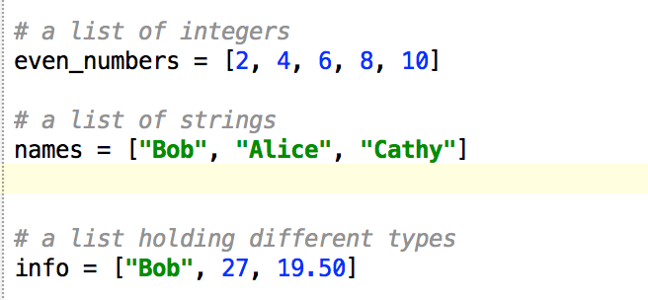
List

Slide 5
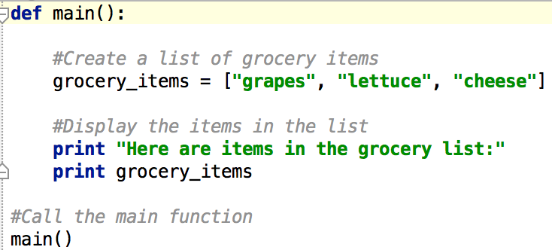
Example Using a List
Output

Slide 6
Print Individual Items in List
Iterate over list
Iteration: one execution of the body of a loop
What kind of loop should we use?
For loop

Slide 7
For Loop
Count-Controlled loop: iterates a specific number of times
Use a for statement to write count-controlled loop
Designed to work with sequence of data items
Iterates once for each item in the sequence
General format:
for variable in [val1, val2, etc]:
statements

Slide 8
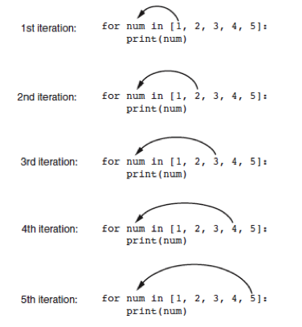
Print Individual Items in List

Slide 9
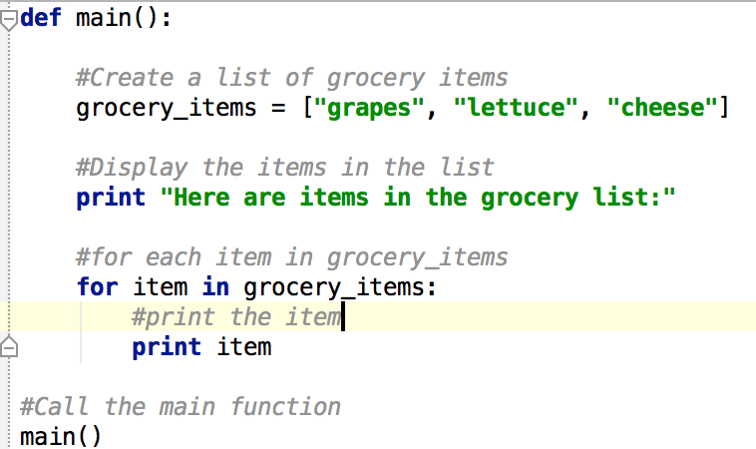
Printing Items in An Individual List
Output

Slide 10
Accessing a Single Item in a List
Indexing
Index: a number specifying the position of an element in a list
Index of first element in the list is 0, second element is 1, and n’th element is n-1
Negative indexes identify positions relative to the end of the list
The index -1 identifies the last element, -2 identifies the next to last element, etc.

Slide 11
Accessing a Single Item in a List Example
Output

Slide 12
Accessing a Single Item in a List Example
How would we print the second item in the list?
Output

Slide 13
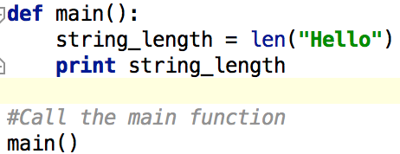
Determine number of Items in List
Just like we could determine the number of characters in a string
Use the len function to determine number of items in a list
Output is 3

Slide 14
Lists are Mutable
Mutable sequence: the items in the sequence can be changed
– Lists are mutable, and so their elements can be changed
An expression such as
list[1] = new_value can be used to assign a new value to a list element

Slide 15
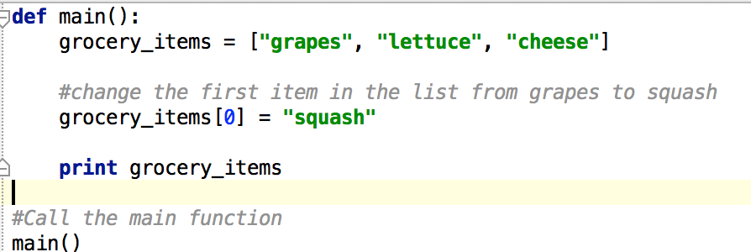
Changing an Item in a List
Output

Slide 16
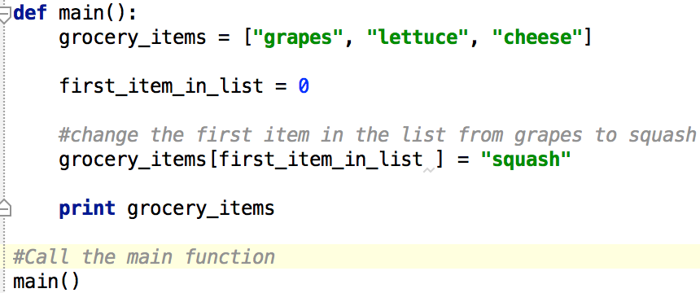
Changing an Item in a List
Output

Slide 17
Practice
Write a function called getUserInput that
Asks the user for his/her name
Asks the user for his/her birthday
Asks the user for his/her email address
Returns the name, birthday, email address as a list
Write a function called main that calls user input and prints the name, birthday, and email address

Slide 18
Practice
Create a function called findAverage(numbers)
This function takes of all the numbers in the list as input
This function returns the average of all the numbers in the list
Create a main function that creates a list of numbers (variable name is numbers), calls findAverage, and prints the average
The numbers are 10, 20, 24, 46, 65, 86, 98

